Slide 1

Unit 14

Slide 2

Unit 14
I remember meeting
all of you in Grade 7.

Slide 3



Slide 4


1. To learn to look ahead to the future.
2. To learn to talk about the future:
— What do you hope to do in the
future?
— I hope to …
3. To learn to use some words and expressions:
degree manager believe in

Slide 5


Do you hope to get a business degree and become a manager? What do you hope to do in the future?

Slide 6
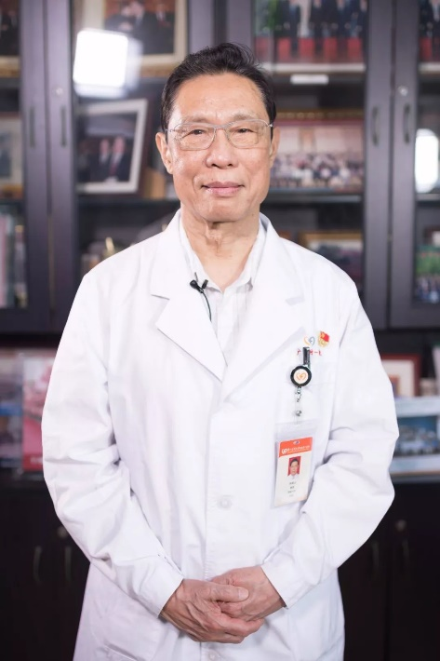
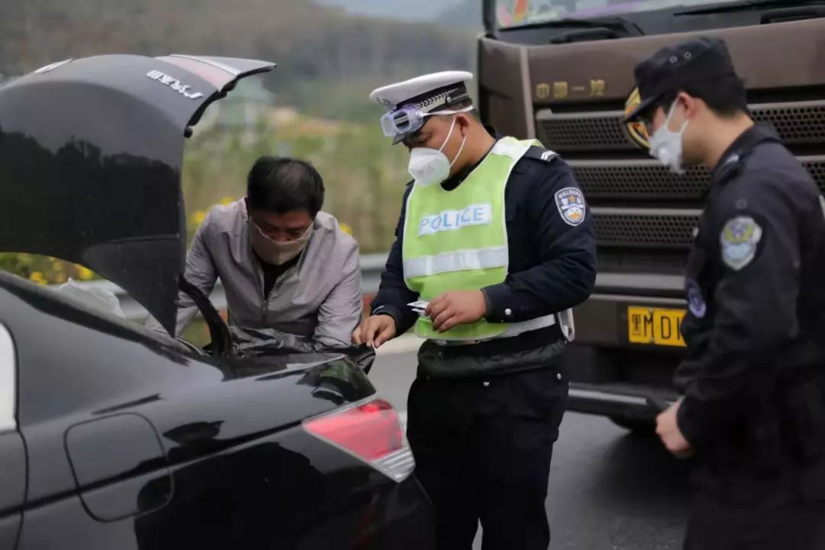
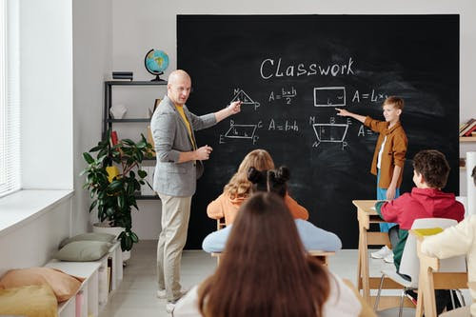
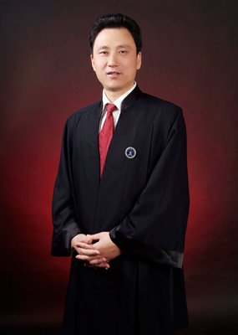
policeman
doctor
What do you hope to do in the future?
lawyer
teacher

Slide 7

Write about what you would like to do in the future.
1a
n. (大学)学位；度数；程度
1. get a business degree and become a
manager
2. ___________________________________
3. ___________________________________
…
n. 经理；经营者
travel around the world with my families
become an astronaut or a doctor

Slide 8

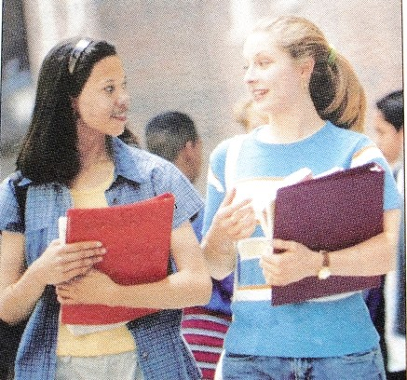
1b
Talk about what you hope to do in the future.
I hope to …
What do you hope to do in the future?

Slide 9



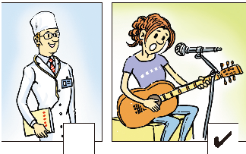
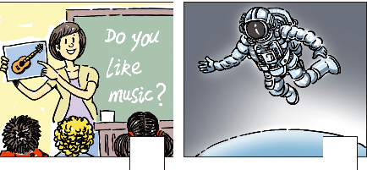
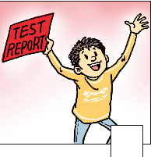
Listen to a class discussion. Check(√) the hopes you hear.
1c
√
√
√

Slide 10

Listen again and finish the column.
Person | Hopes to…
Bob
Shirley
Ken
Anna
pass the exam to get into senior high school
get into a music school, play in a band
be an astronaut, go into space
improve her English to teach kids English in the future

Slide 11

Listen again. Complete the passage.
1d
Today is the students’ last class. Bob feels _____ about it and thinks Mrs. Chen’s classes have been ______. The students talk about what they want to do in the future. Bob hopes to _____ the exam to get into senior high school. Shirley wants to get into a ______ school.
sad
great
pass
music

Slide 12
prize
Ken is good at _______ and he won a _____ for it. So he wants to be a(n) _________.
Mrs. Chen believes in all of them and tells
them to “________”. To celebrate the end of junior high, they are having a ______. They ask Mrs. Chen to come, and she is happy to accept the invitation.
science
astronaut
信任, 信赖
go for it
party

Slide 13
believe in 信任；信赖
e.g. They need a leader they can believe in.
相信……的存在
e.g. My younger brother believes in aliens, but I don’t.

Slide 14
【语境应用】完成句子。
1) 我相信他所说的，因为我信任他。
I ______ ______ ______ ______ because I
______ ______ him.
2) 她说她没有带钱，你相信她的话吗？
She said she didn't take the money. Do you
_______ _______?
3) 信任自己，否则你永远不会成功。
________________, or you’ll never succeed.
believe what he said
believe in
believe her
Believe in yourself

Slide 15
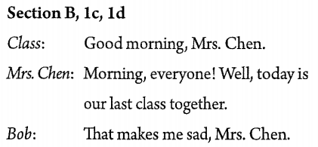
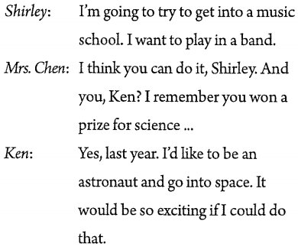
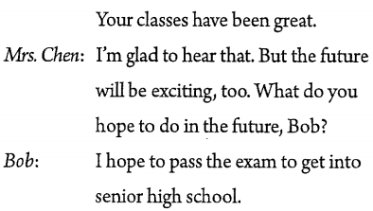
Listen to the class discussion again and retell it.

Slide 16
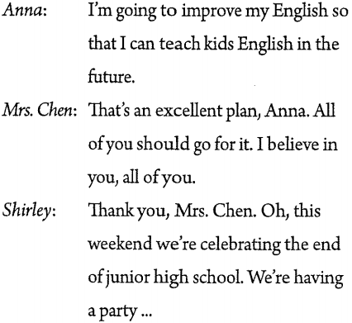
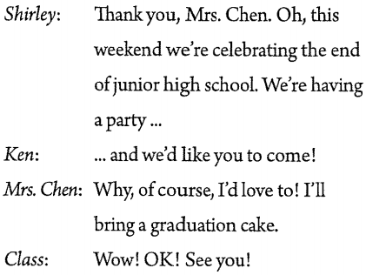

Slide 17



Have you ever given a speech in front of people?
What was it like?
What did you speak about?

Slide 18
Giving the Speech
1. Practice reading the speech aloud.
2. Review what you’ve written and make any necessary revisions.
3. Present your speech with confidence. Speak in a loud & clear voice.

Slide 19

Prepare a speech for your graduation. Use the questions to help you. Present your speech to your group.
1e
How have you changed since you started junior high school?
Who has helped you most?
What advice have your parents given you?
What will you do after you graduate?
What are you looking forward to?

Slide 20
Speech Contest
Write a speech in groups. And then try to give the speech to the whole class. Let’s see which group is the best.

Slide 21


将来
信任；信赖
接受邀请
初中
获得商学位
in the future
believe in
accept the invitation
junior high school
get a business degree

Slide 22


Ⅰ. 根据句意及所给汉语提示，写出句中所缺
单词。
1. Monica was about to tell me what had
happened when the __________(经理)
came into our office.
2. If you want to get the job, you must have
rich experience, a(n) __________(学位)
and a good knowledge of English.
manager
degree

Slide 23


1. Make a list about what you hope to do in the future and give the reasons.
2. Preview the article on page 110.

Slide 24


